Slide 1

The insight of gitinsight
!MIRJAM NILSSON​

Slide 2

Dagsorden
Early preparation
Aha-oplevelser
TESTING
Design patterns
architectural patterns

Slide 3
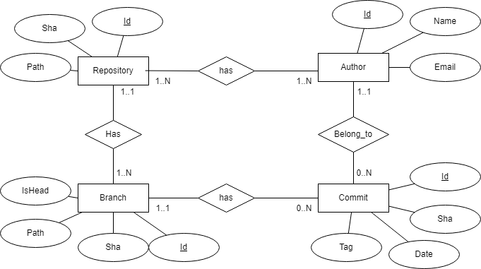
Early preparation
Week 44: ER-diagram

Slide 4


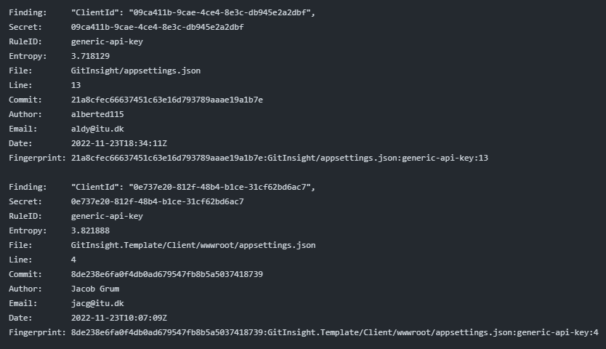
Megalinter
Jacob der sætter megalinter op dag 1
Warning > Error
Disable auto apply
93 failures

Slide 5

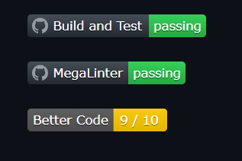
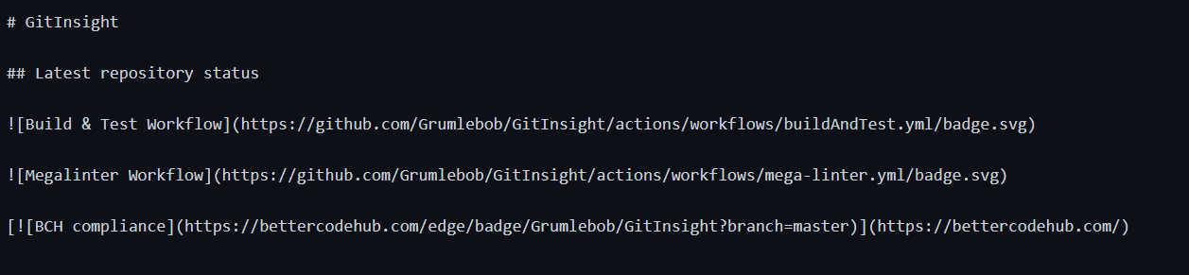
Badges
Worth it? Yes!

Slide 6
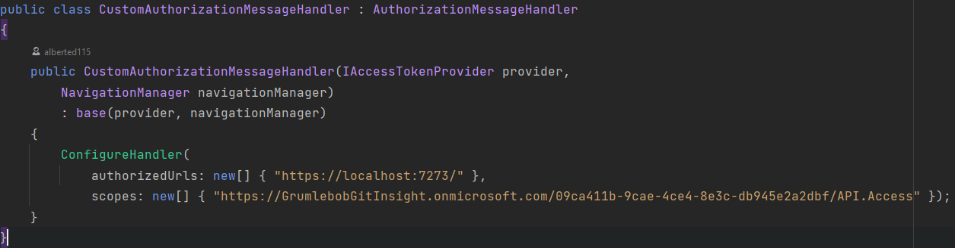
Authorisation
TA’s guide var ikke top notch, da den krævede betaling.
Vi endte med at bruge: https://learn.microsoft.com/en-us/aspnet/core/blazor/security/webassembly/hosted-with-azure-active-directory-b2c?view=aspnetcore-7.0
+ En uges tid på at troubleshoot for at finde den hemmelige ingrediens!

Slide 7

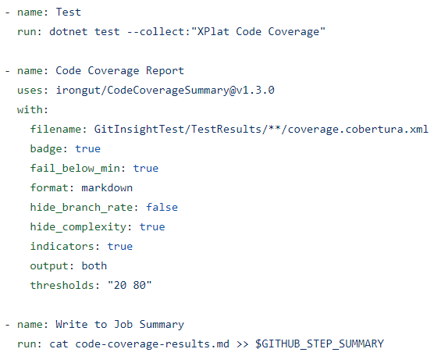
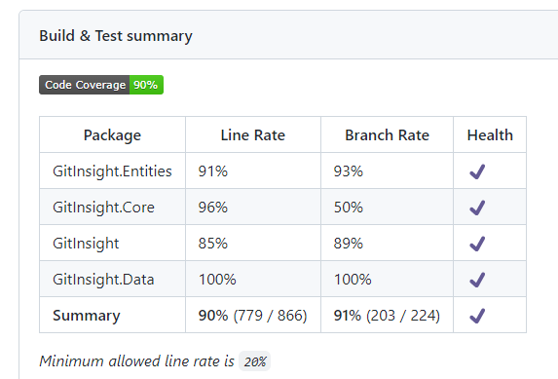
Testing
51 build and test failures
Automatic Code Coverage report

Slide 8
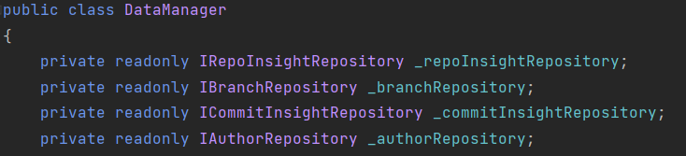
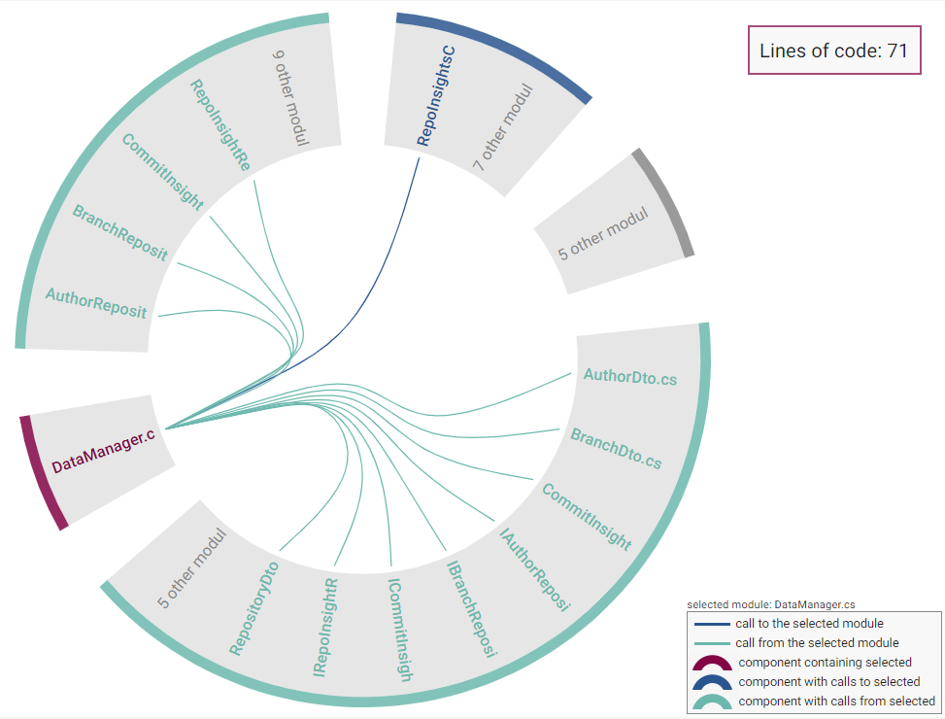
Design patterns
Façade

Slide 9
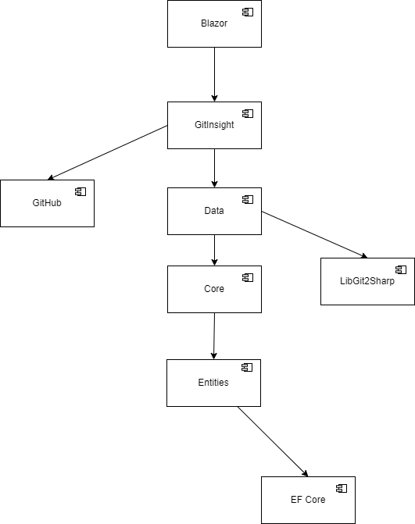

Architecutral pattern
Onion/Cake/Parfait Architecture
”Have you ever met someone who don’t like parfait”
Repository Architecture

Slide 10
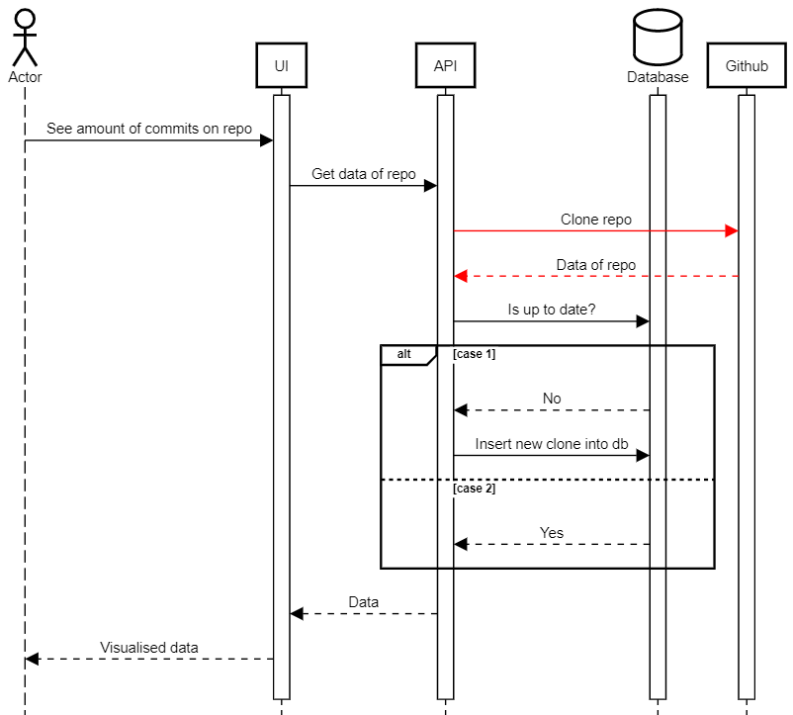
El problemo

Slide 11


Demo

